Slide 1
AZURE WEB APP & AZURE STORAGE ACCONUT
MANOJ

Slide 2
AZURE WEB APP
Azure Web Apps is a cloud computing based platform for hosting websites, created and operated by Microsoft. It is a platform as a service (PaaS) which allows publishing Web apps running on multiple frameworks and written in different programming languages (.NET, node.js, PHP, Python and Java), including Microsoft proprietary ones and 3rd party ones.

Slide 3
App Service not only adds the power of Microsoft Azure to your application, such as security, load balancing, auto scaling, and automated management.
You can also take advantage of its DevOps capabilities, such as continuous deployment from Azure DevOps, GitHub, Docker Hub, and other sources, package management, staging environments, custom domain.

Slide 4
LAB1: CREATE AZURE WEB APP
Publish your web app:
To publish your web app, you must first create and configure a new App Service that you can publish your app to.
As part of setting up the App Service, you'll create:
A new resource group to contain all of the Azure resources for the service.
A new Hosting Plan that specifies the location, size, and features of the web server farm that hosts your app.

Slide 5
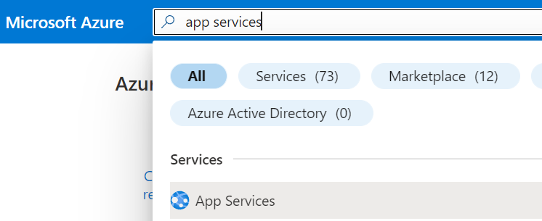
Follow these steps to create your App Service resources and publish your project:
Type app services in the search. Under Services, select App Services.

Slide 6
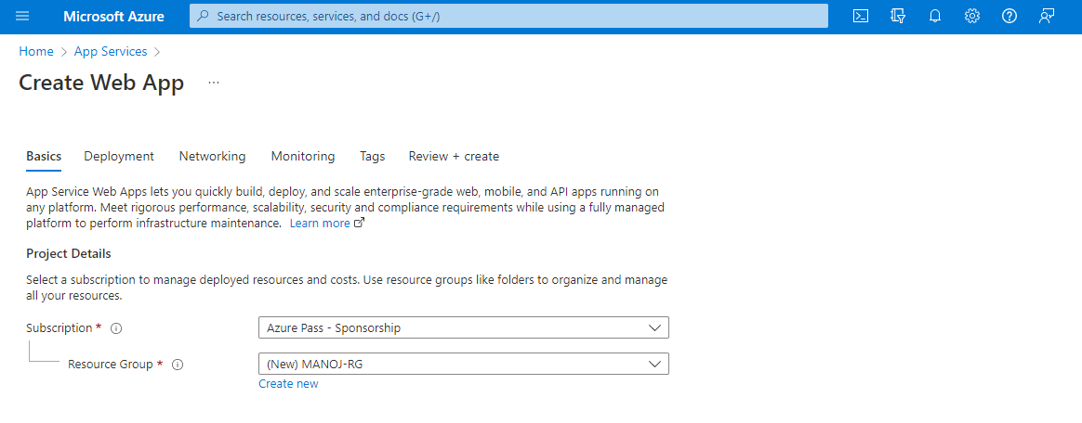
In the App Services page, select + Create.
In the Basics tab, under Project details, ensure the correct subscription is selected and then select to Create new resource group. Type MANOJ-RG for the name.

Slide 7
Under Name, type a globally unique name for your web app.
Under Publish, select Code.
Under Runtime stack select ASP.NET V4.8.
Select an Operating System, and a Region you want to serve your app from.

Slide 8
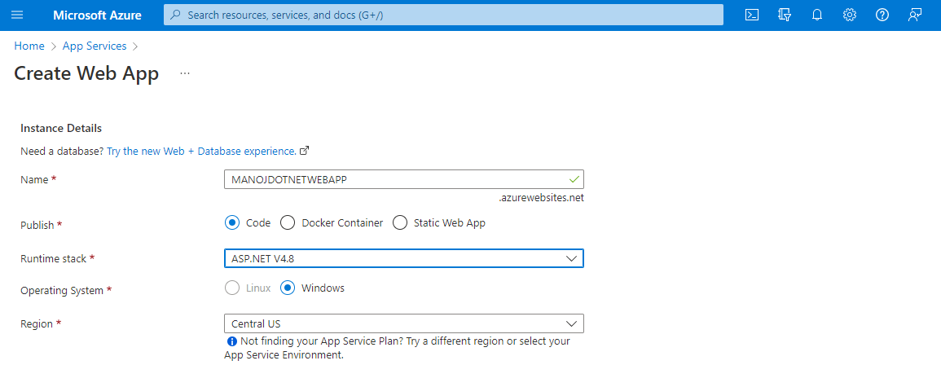

Slide 9
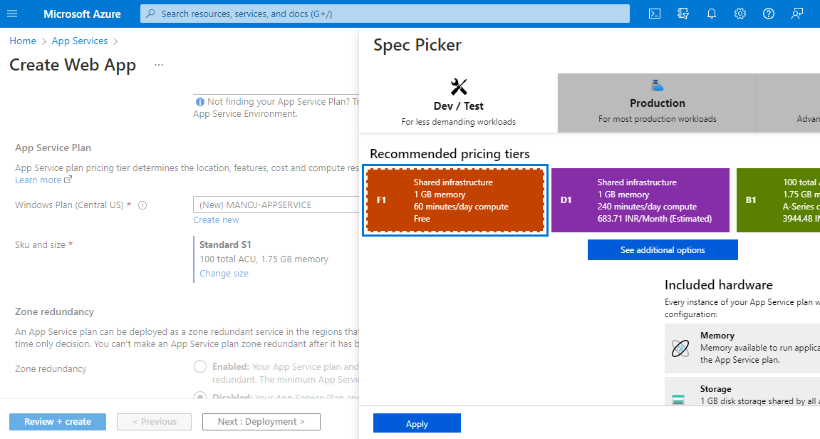
Under App Service Plan, select Create new App Service Plan. Type MANOJ-APPSERVICE for the name. To change to the Free tier, select Change size, select Dev/Test tab, select F1, and select the Apply button at the bottom of the page.

Slide 10
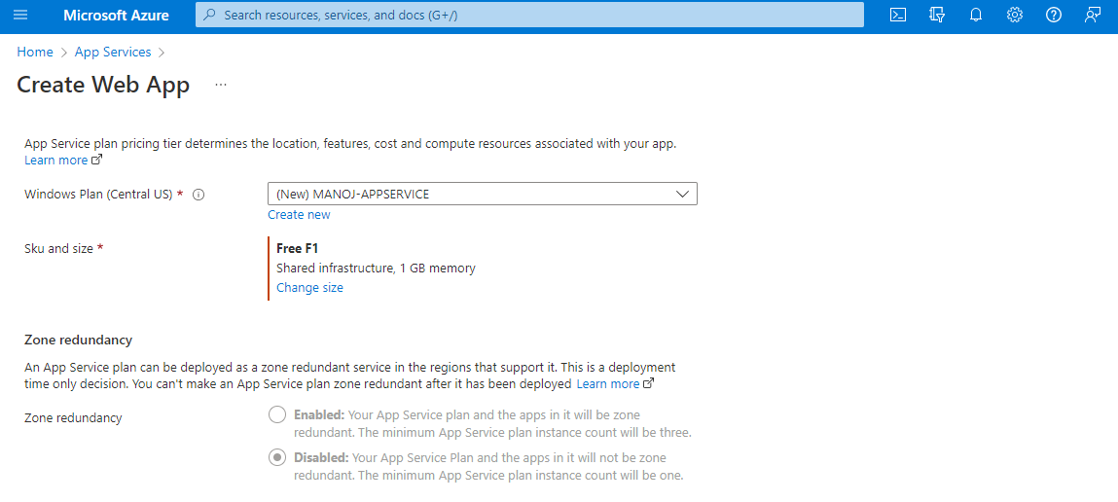

Slide 11
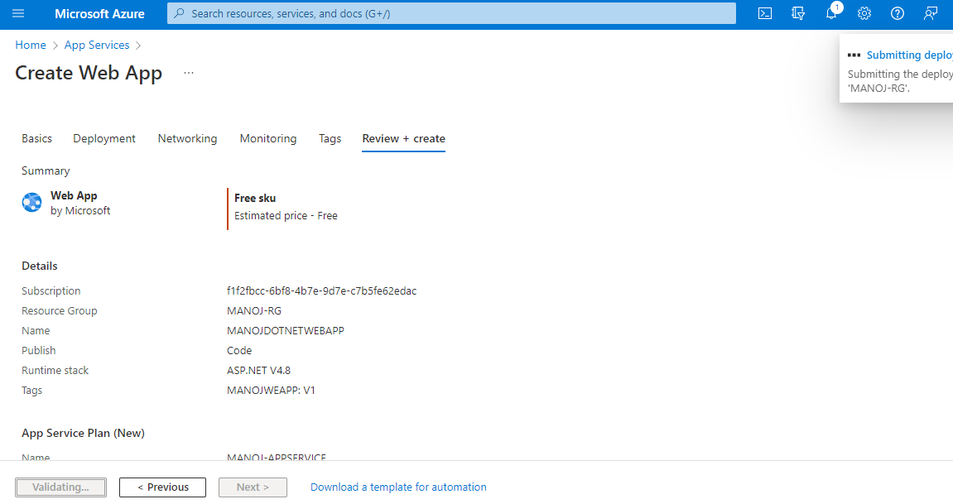
Select the Review + create button at the bottom of the page.
After validation runs, select the Create button at the bottom of the page.
After deployment is complete, select Go to resource.

Slide 12
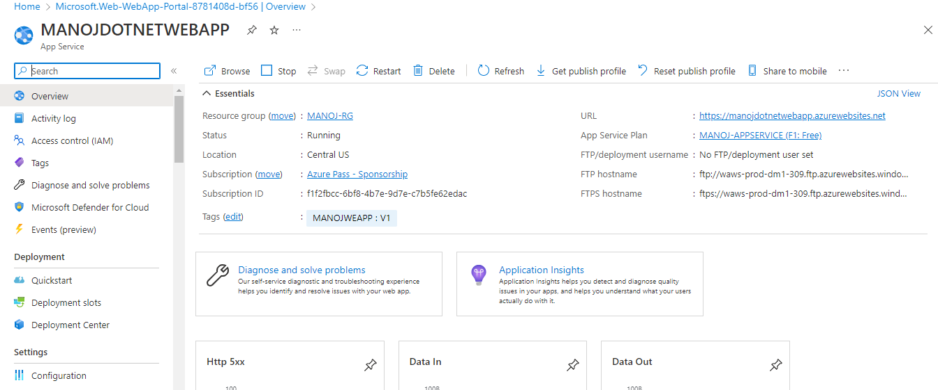

Slide 13
AZURE STORAGEACCOUNT

Slide 14
An Azure storage account contains all of your Azure Storage data objects, including blobs, file shares, queues, tables, and disks. The storage account provides a unique namespace for your Azure Storage data that's accessible from anywhere in the world over HTTP or HTTPS via a REST API.

Slide 15
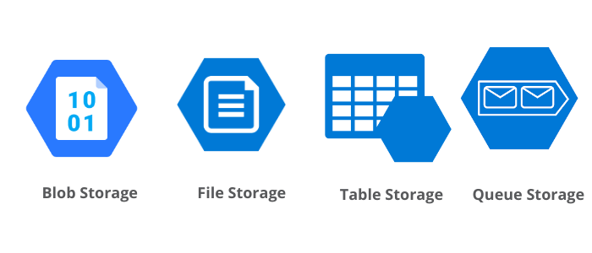
Azure Storage data services
Azure Blob
Azure Queues
Azure file
Azure Table
1. Azure Blob: We can have Azure Blob storage within the storage account, which is used to store the unstructured data such as media files, documents, etc.

Slide 16
Blob storage is designed for:
Serving images or documents directly to a browser.
Storing files for distributed access.
Streaming video and audio.
Writing to log files.
Storing data for backup and restore, disaster recovery, and archiving.
Storing data for analysis by an on-premises or Azure-hosted service.

Slide 17
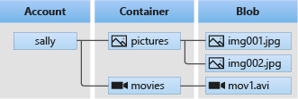
Blob storage resources
Blob storage offers three types of resources:
The storage account
A container in the storage account
A blob in a container
The following diagram shows the relationship between these resources.

Slide 18
Storage accounts
A storage account provides a unique namespace in Azure for your data. Every object that you store in Azure Storage has an address that includes your unique account name.
Containers
A container organizes a set of blobs, similar to a directory in a file system. A storage account can include an unlimited number of containers, and a container can store an unlimited number of blobs.

Slide 19
A container name must be a valid DNS name, as it forms part of the unique URI used to address the container or its blobs. Follow these rules when naming a container:
Container names can be between 3 and 63 characters long.
Container names must start with a letter or number, and can contain only lowercase letters, numbers, and the dash (-) character.
Two or more consecutive dash characters aren't permitted in container names.

Slide 20
Blob Types:
Azure offers three types of blob service:
1. Block blob: It stores text binary data up-to about 4.7 TB. It is the block of data that can be managed individually. We can use block blobs mainly to improve the upload-time when we are uploading the blob data into Azure. When we upload any video files, media files, or any documents. We can generally use block blobs unless they are log files.
2. Append blob: It is made up of blocks like block blobs, but are optimized for append operations. It is ideal for an application like logging data from virtual machines.
For example - application log, event log where you need to append the data to the end of the file. So when we are uploading a blob into a container using the Azure portal or using code, we can specify the blob type at that time.
3. Page blob: It stores random access files up-to 8 TB. Page blobs store the VHD files that backs VMs.

Slide 21
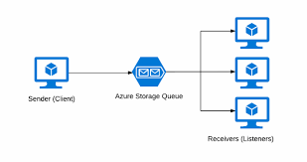
2 . Azure Queues:
A queue contains a set of message. Queue name must be all lowercase
It is a service for storing a large number of messages in the cloud that can be accessed from anywhere in the world using HTTP and HTTPS.
A single queue message can be up to 64KB in size. A message can remain in the queue for a maximum time of 7 days

Slide 22
3. Azure file :
Azure file storage mainly can be used if we want to have a shared drive between two servers or across users. In that case, we will go for Azure file storage.
In the Azure file storage structure, the first thing we need to have is an Azure storage account. Azure file storage is offered under the umbrella of the Azure storage account. And once we have created an Azure storage account, we'll create a file share.

Slide 23
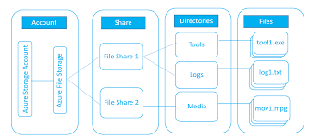

Slide 24
Share: A file storage Share is an SMB file share in Azure. The directories and files must be created in a parent's Share, so we can't create a directory directly in a storage account.
We need file storage share, first created, and then we can create directories to upload. An account may contain an unlimited number of shares, and
a Share can store an unlimited number of files, up to 5 TB total capacity of the file share.
But, in case we need more than the full capacity, then we can create another file share
Directory: It is an optional hierarchy of directories.
File: A file in the share. A file may be up to 1 TB in size.
URL format: For a request to an Azure file share made with the file REST protocol

Slide 25
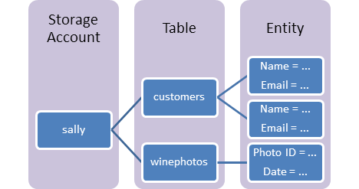
Azure Table storage:
Azure Table storage is used for storing a large amount of structured data. This service is a NoSQL data storage, which accepts authenticated calls from inside and outside of the Azure cloud. It is ideal for storing structured and non-relational data.

Slide 26
Access Tiers :
There are four types of access tiers available:
Premium Storage (preview): It provides high-performance hardware for data that is accessed frequently.
Hot storage: It is optimized for storing data that is accessed frequently.
Cool Storage: It is optimized for storing data that is infrequently accessed and stored for at least 30 days.
Archive Storage: It is optimized for storing files that are rarely accessed and stored for a minimum of 180 days with flexible latency needs (on the order of hours).

Slide 27
Lab2 : Create Storage Account
On the Storage accounts page, select Create.
On the Basics tab, provide the essential information for your storage account. After you complete the Basics tab, you can choose to further customize your new storage account by setting options on the other tabs, or you can select Review + create to accept the default options and proceed to validate and create the account.

Slide 28
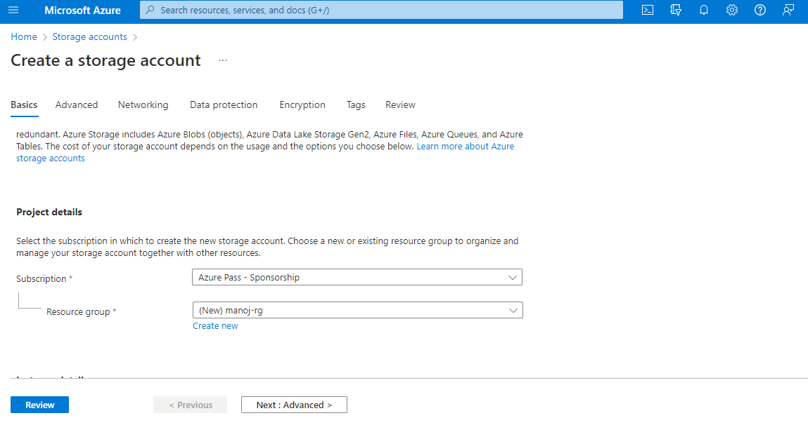
The following image shows a standard configuration of the basic properties for a new storage account.

Slide 29
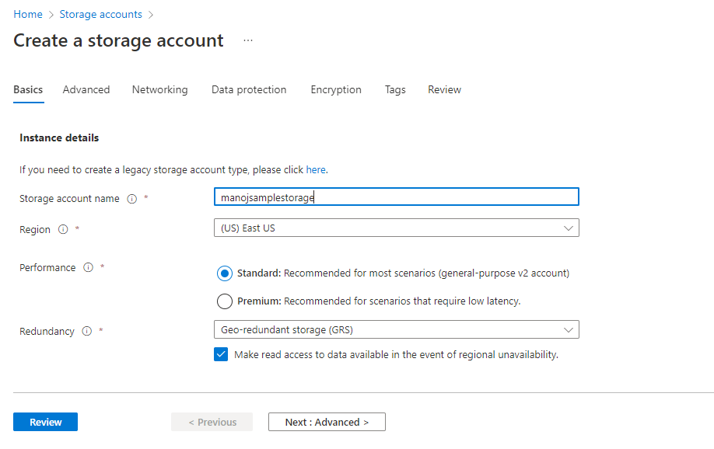

Slide 30
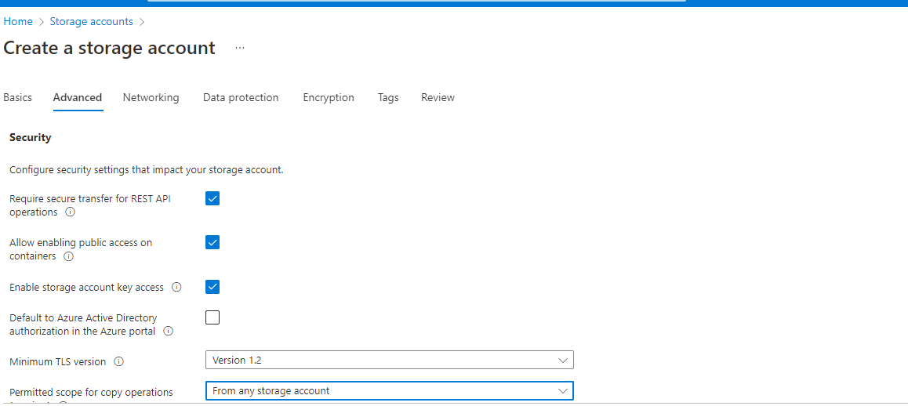
On the Advanced tab, you can configure additional options and modify default settings for your new storage account. Some of these options can also be configured after the storage account is created, while others must be configured at the time of creation.

Slide 31
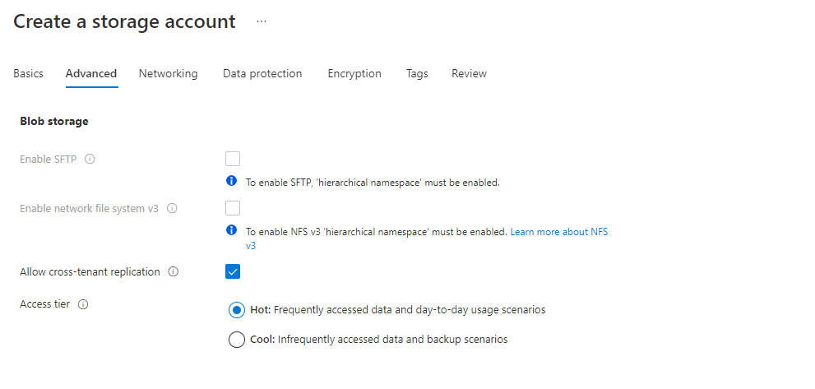

Slide 32
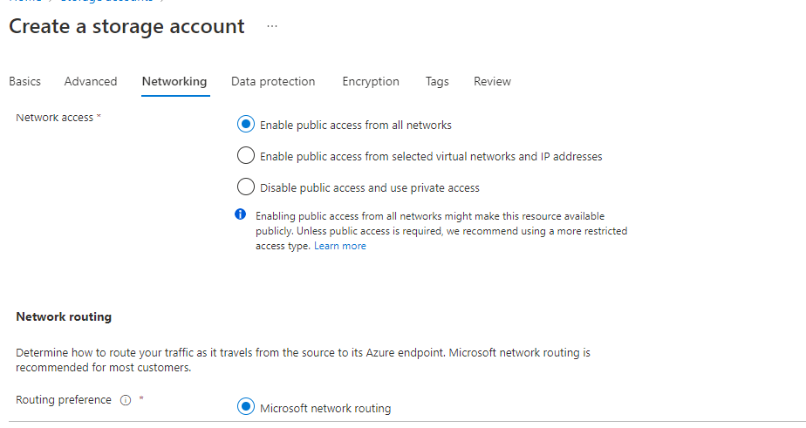
On the Networking tab, you can configure network connectivity and routing preference settings for your new storage account. These options can also be configured after the storage account is created.

Slide 33
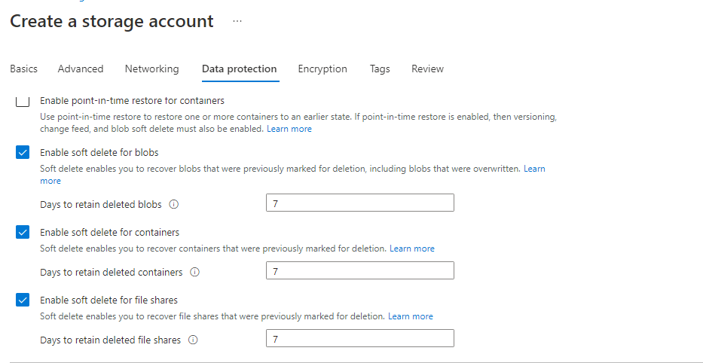
On the Data protection tab, you can configure data protection options for blob data in your new storage account. These options can also be configured after the storage account is created

Slide 34
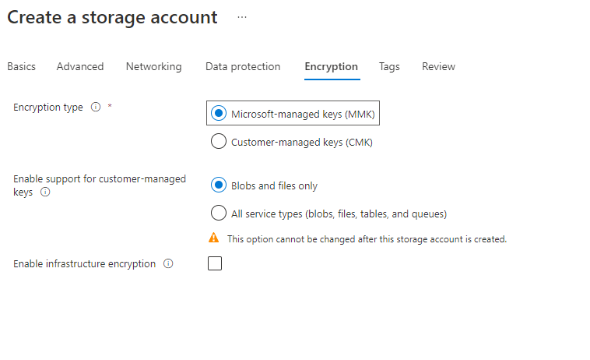
On the Encryption tab, you can configure options that relate to how your data is encrypted when it is persisted to the cloud.

Slide 35
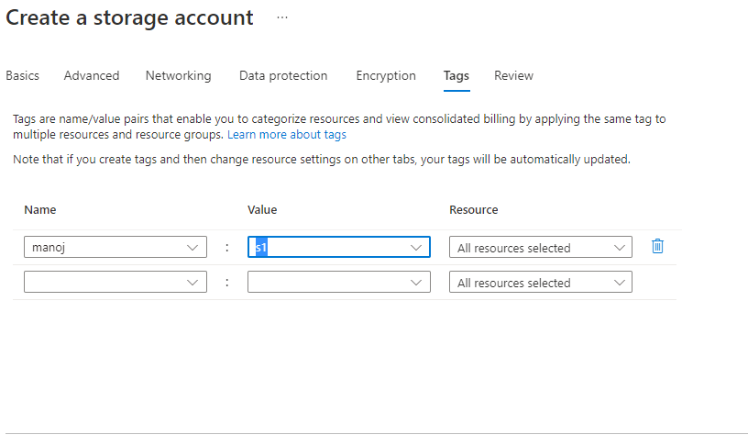
On the Tags tab, you can specify Resource Manager tags to help organize your Azure resources.

Slide 36
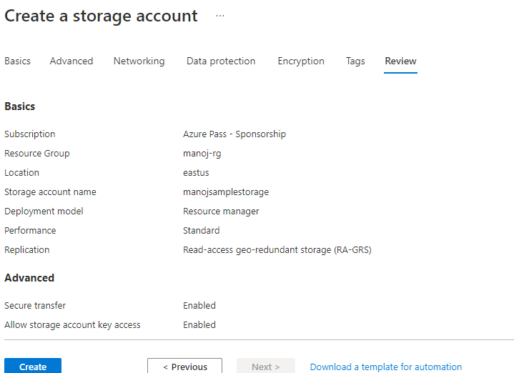
When you navigate to the Review + create tab, Azure runs validation on the storage account settings that you have chosen. If validation passes you can proceed to create the storage account.

Slide 37
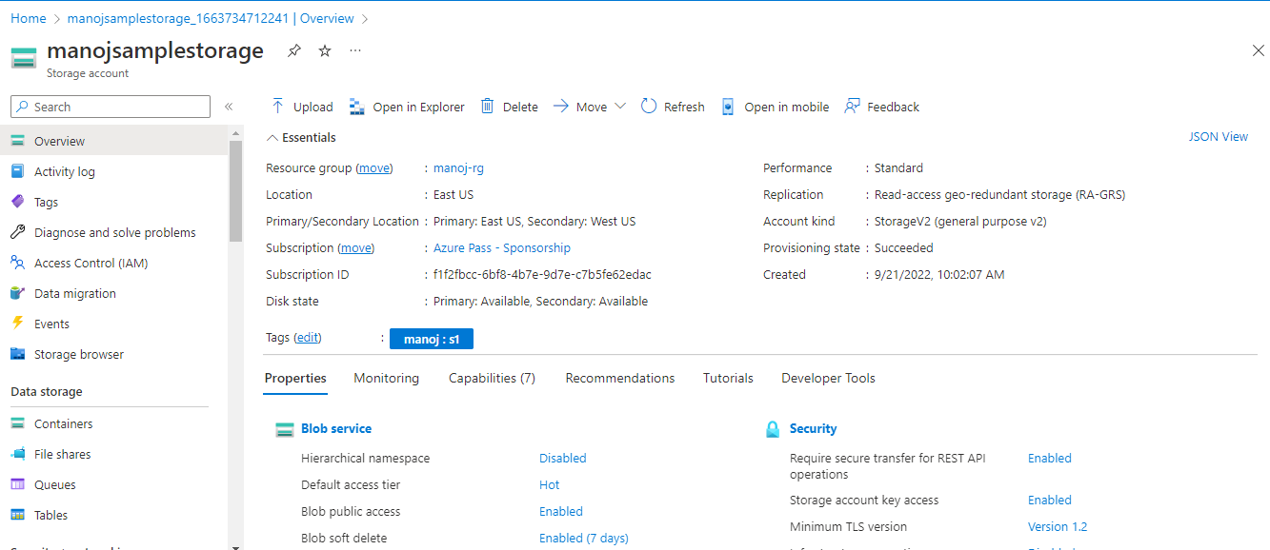

Slide 38
Lab3: Create Container
In the portal navigation pane on the left side of the screen, select Storage accounts and choose a storage account. If the navigation pane isn't visible, select the menu button to toggle its visibility.
In the navigation pane for the storage account, scroll to the Data storage section and select Containers.
Within the Containers pane, select the + Container button to open the New container pane.

Slide 39
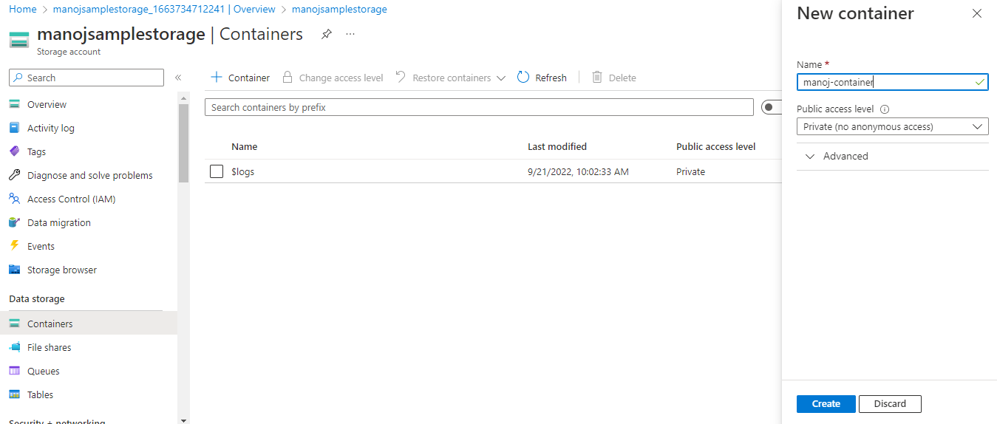
Within the New Container pane, provide a Name for your new container. The container name must be lowercase, must start with a letter or number, and can include only letters, numbers, and the dash (-) character

Slide 40
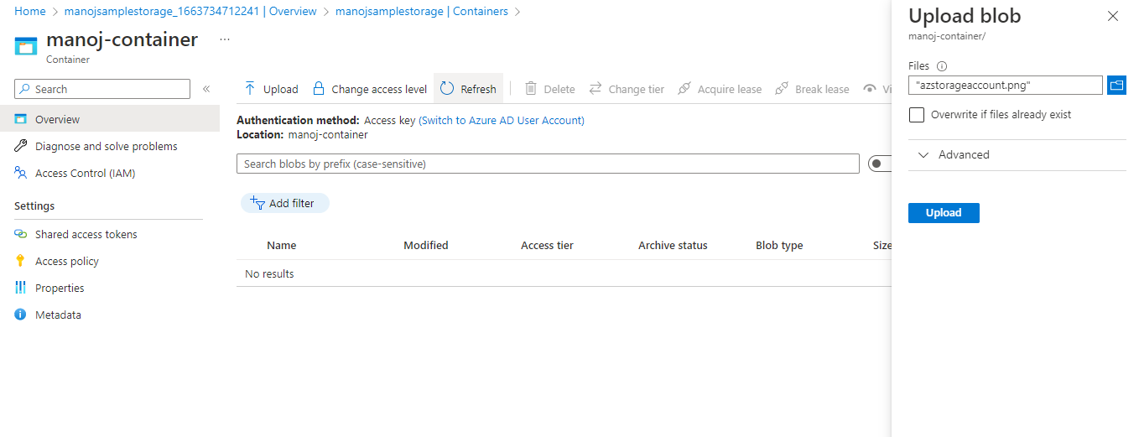
In the container upload a image.

Slide 41
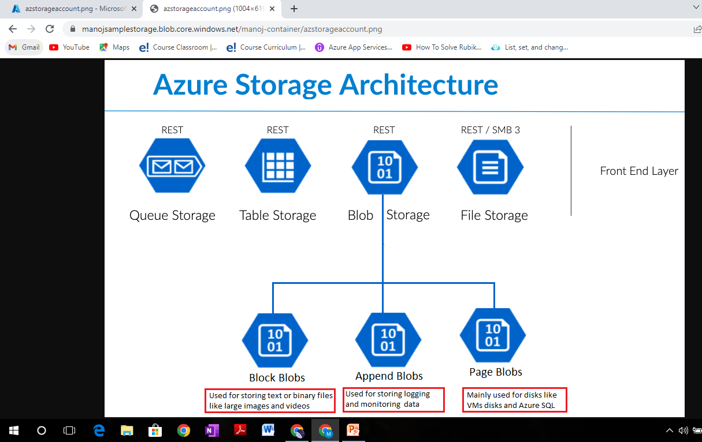
Copy and Paste the container URL.

